Slide 1
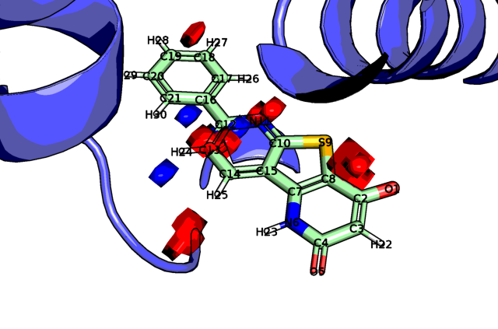
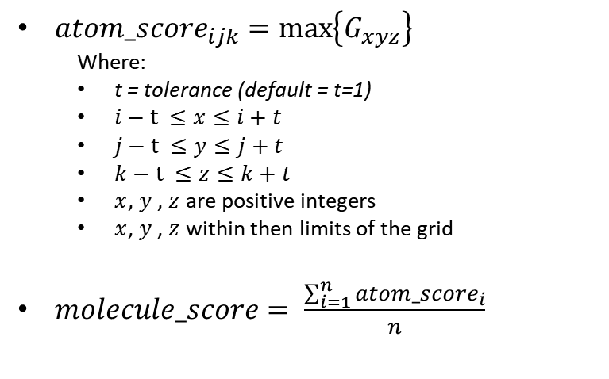

Scoring Molecules: Simple
Method:
Example:
${atom_score}_{ijk}=\max\left\{G_{xyz}\right\}$
Where:
t = tolerance (default = t=1)
$i−t ≤x≤i+t$
$j−t ≤y≤j+t$
$k−t ≤z≤k+t$
$x$, $y$ , $z$ are positive integers
$x$, $y$ , $z$ within then limits of the grid
$molecule_score= \frac{\sum_{i=1}^{n}{{atom_score}_{i}}}{n}$
Including grid points within tolerance $(t)$ ensures Atom_{O1} gets scored. Atom_{S9} also gets scored by this acceptor feature
Atom Label | Atom Score | Atom Type
O1 | 13.63 | acceptor
O5 | 0.00 | acceptor
N6 | 0.00 | donor
S9 | 18.91 | acceptor
Mean | 14.70
Atom_{N6} and Atom_{O5} correctly scored as 0.0
Notes:
The atom score is determined by:
The atom type is determined (i.e. apolar, donor, acceptor)
The atoms grid index is determined by finding the closest grid point to the atomic coordinate.
The maximum value of that grid point and the adjacent points (including diagonals) on the appropriate grid (acceptor atoms lookup on acceptor grid) is taken as the atom score.
The molecule score is the mean of the atom scores (only heavy atoms used).

Slide 2
Scoring Molecules: Simple
Limitations:
Example:
Apolar atom scores dominate and therefore greasy ligands are prioritised. This is because there are more apolar atoms in most lead molecules and the apolar maps are more diffused compared with the polar maps
Imprecise treatment of atoms as cubes
No account for clashes with the protein
No account for atom mismatches with the hotspots maps. (i.e. donor atoms in high scoring acceptor regions)
Including grid points within tolerance $(t)$ ensures Atom_{O1} gets scored. Atom_{S9} also gets scored by this acceptor feature
Atom Label | Atom Score | Atom Type
O1 | 13.63 | acceptor
O5 | 0.00 | acceptor
N6 | 0.00 | donor
S9 | 18.91 | acceptor
Mean | 14.70
Atom_{N6} and Atom_{O5} correctly scored as 0.0

Slide 3
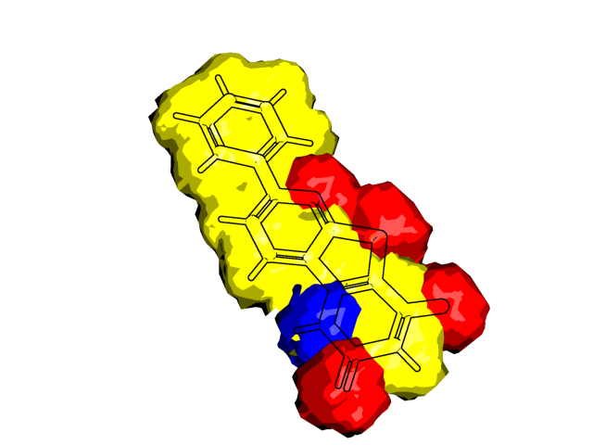
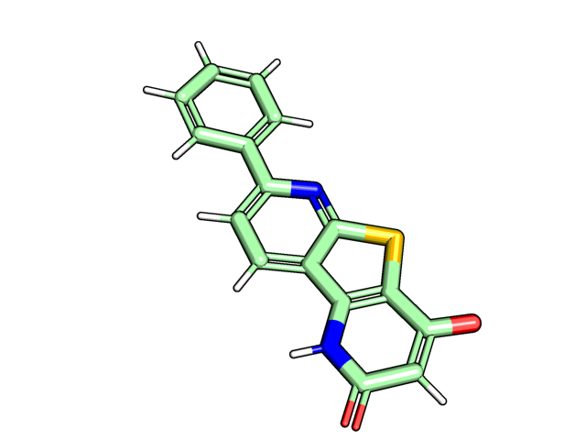
Scoring Molecules:
Method
Example
Represent molecule as a Grid
Atoms are categorised by interaction type (i.e. apolar, donor, acceptor). Grid points, on the corresponding interaction grid, within the VDW radius of the atom are set to 1.

Slide 4
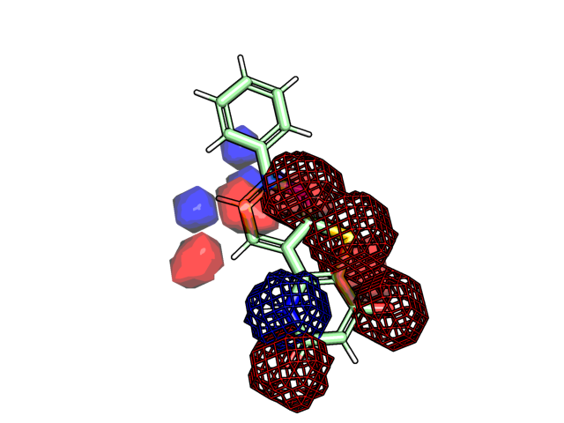
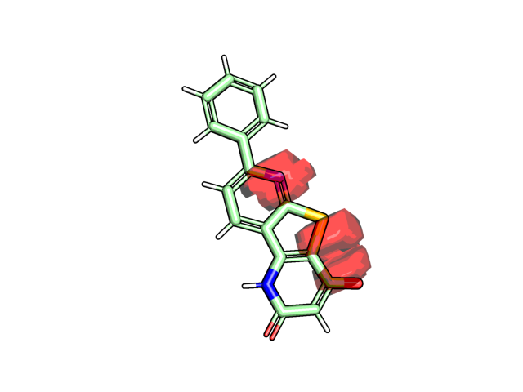
Scoring Molecules:
Method
Example
Represent molecule as a Grid
Find union of matching hotspots and molecule grid
Grid points which have a value in both the hotspot and molecule grids are retained. Additionally, points clashing with the protein are removed here.
*apolar grid omitted for clarity ** hotspot maps dilated
Molecule Grids (Mesh)
Hotspots Grids (Surface)
Union

Slide 5
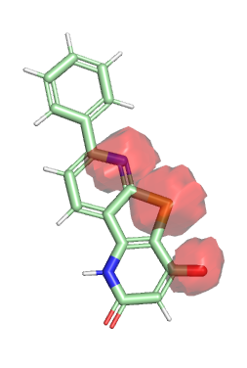
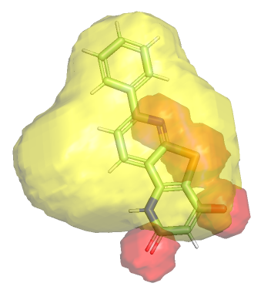
Scoring Molecules:
Method
Example
Represent molecule as a Grid
Find union of matching hotspots and molecule grid
Find union of non-matching hotspots and molecule grid
For a given molecule grid type (acceptor shown), the overlap with the other grid types in the hotspots map is found (i.e apolar). Placing polar atoms in hydrophobic regions is less favourable.
Molecule Grids (acceptor)
Hotspots Grids (apolar)
Union
Values = sum of apolar + donor grids
Within acceptor VDW r

Slide 6



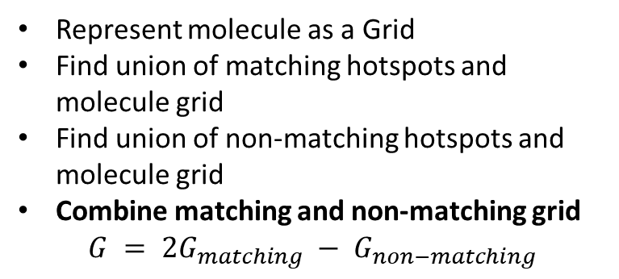
Scoring Molecules:
Method
Example
Represent molecule as a Grid
Find union of matching hotspots and molecule grid
Find union of non-matching hotspots and molecule grid
Combine matching and non-matching grid
$$G = 2G_{matching} − G_{non−matching}$$
acceptor
donor
apolar

Slide 7
Scoring Molecules:
Method
Example
Blue regions are where the molecule does not match the hotspot.
Represent molecule as a Grid
Find union of matching hotspots and molecule grid
Find union of non-matching hotspots and molecule grid
Combine matching and non-matching grid
Score for each interaction type is the mean of the non-zero grid points
Orange / red regions are where the molecule matches the hotspot,
acceptor
donor
apolar

Slide 8
Scoring Molecules:
Method
Example
Blue regions are where the hotspot does not match well.
The rescoring script is a “cookbook” example of how the Fragment hotspot maps can be used to rescore ligands. There are many different ways that this can be done. For best results the rescoring scheme should be tailored to the problem in hand.
Represent molecule as a Grid
Find union of matching hotspots and molecule grid
Find union of non-matching hotspots and molecule grid
Combine matching and non-matching grid
Score for each interaction type is the mean of the non-zero grid points
Orange / red regions are where the molecule matches the hotspot well,
acceptor
donor
apolar

